Slide 1
Social Networking Safety

Slide 2
Dangers of online social networking
Facebook Twitter
Instagram
Notes:
This morning the ICT department are happy to have the opportunity to remind you of the dangers of online social networking, primarily regarding the use of Facebook.
Many of you will have your own page on a social networking site such as Twitter, Instagram or Facebook. These sites are a great way to make new friends and keep in contact with old friends. Most of the things that you post are harmless and won’t cause you any problems, but some of you have pictures of yourself and your friends and personal information you wouldn’t want strangers to know or see.

Slide 3
Can you change your mind?
Is it really private?
Notes:
But you can just delete your information if you change your mind later, can’t you? Well maybe it isn’t that easy as one student found out when he tried unsuccessfully over 50 times to get details removed from his page.
It is very important you know how to be safe online and even if you’ve made your page private some people will still be able to access it and remember you have no control over what your friends do with things copied from your site. What happens when friends fall out? What happens if someone finds out your password?

Slide 4
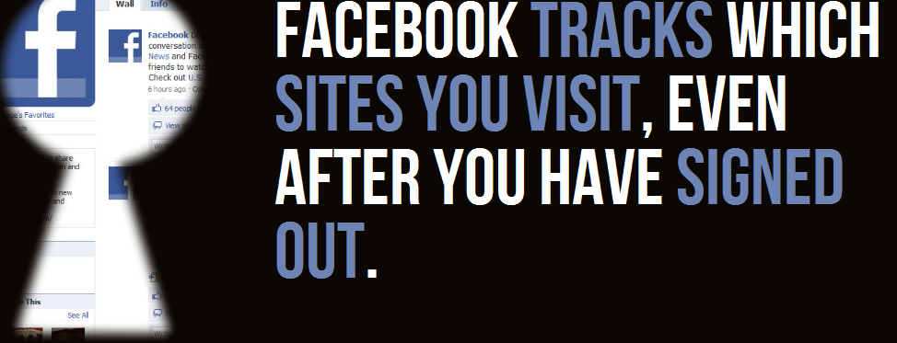
Notes:
Some facts about Facebook. Facebook tracks which sites you visit, even after you have signed out.

Slide 5
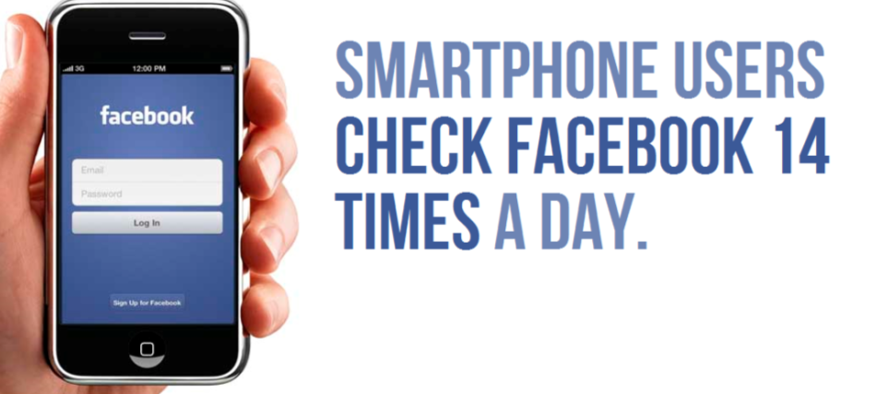
Notes:
Smartphone users check Facebook 14 times a day.

Slide 6
Notes:
8.7% of Facebook users are fake.

Slide 7
Notes:
Several people have been murdered for unfriending someone on Facebook.

Slide 8
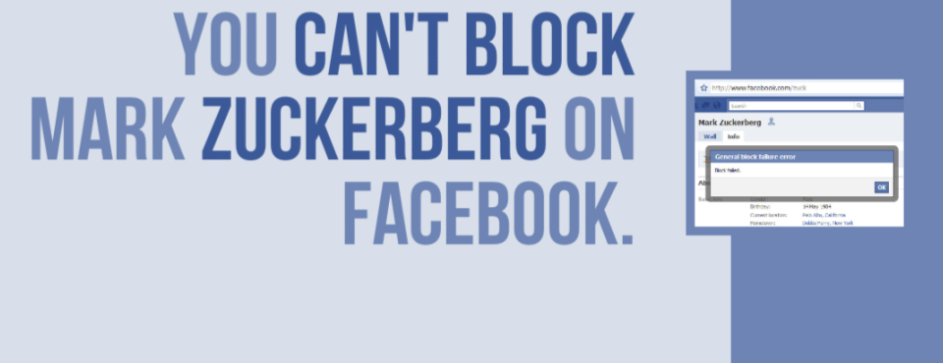
Notes:
You can’t block Mark Zuckerberg on Facebook.

Slide 9
Notes:
There are more Facebook users from the U.S. than U.S. citizens that voted in the last election.

Slide 10
Notes:
In 2014, a burglar in Minnesota was caught after he logged into his Facebook account on the home’s PC and forgot to log out.

Slide 11
Did you know that at least one British university monitors Facebook to gain evidence about pranks and poor behaviour by their students?
Notes:
Did you know that at least one British university monitors Facebook to gain evidence about pranks and poor behaviour by their students?

Slide 12
Did you know that before many employers interview people, they often search social networking sites to find out what the candidate is really like?
Notes:
Did you know that before many employers interview people, they often search social networking sites to find out what the candidate is really like?

Slide 13
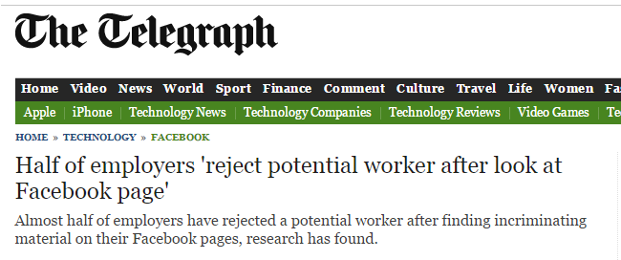
Notes:
This Telegraph article showed that bosses are now using the popular social networking site as a tool to double check how likely it would be that their new worker would:
take a sick day for being hungover etc
Employers also checked to see if potential employees were lying about their qualifications, with employers checking their Facebook pages to see if their online details matched their CV.
One in 10 were knocked back for boasting about drinking online, 13 per cent were refused for making racist comments and nine per cent were overlooked for placing inappropriate photos on their Facebook page.
the biggest online mistake that job seekers made was lying about their qualifications but having their real academic record available for all to see on line. There were 38 per cent of job seekers knocked back for boosting up their qualifications on their resume and then getting caught on Facebook.

Slide 14
So what do you think?
Are social networking sites just a bit of harmless fun and a good way to keep in contact with friends?
or
Do you think that things you have posted might embarrass you in the future?
Notes:
When asked for advice about posting online Career Builder president Farhan Yasin said “Don't forget others can see your friends, so be selective about who you accept as friends. Monitor comments made by others and consider using the block comments feature or set your profile to private so only designated friends can view it."

Slide 15
Key Security Tips
Some key tips for keeping your information as secure as possible on Facebook are:
Notes:
Some key tips for keeping your information as secure as possible on Facebook are:

Slide 16
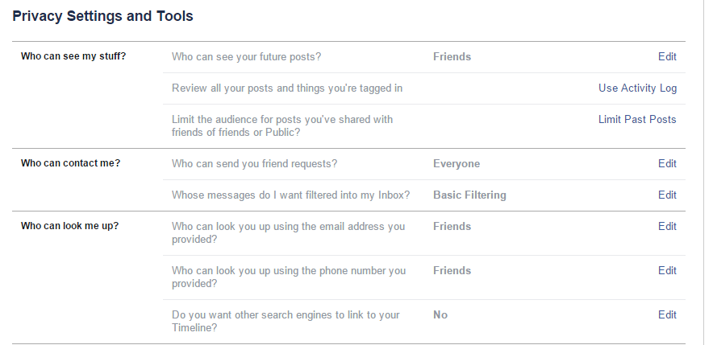
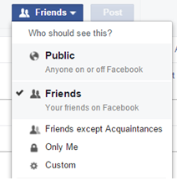
Notes:
Ensure that your Privacy settings are set appropriately.
You can choose who can see your account so ensure that you have chosen either ‘Only Me’ or ‘Friends’ which should prevent others from seeing your account.
You can also ensure that search engines cannot find your account if your name is typed into it which can limit who can access your account.

Slide 17
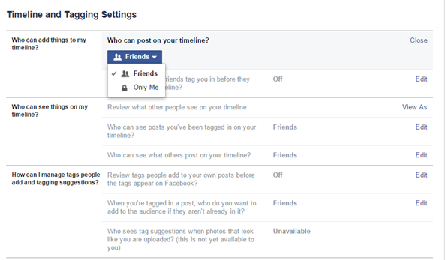
Notes:
You can set your account so that items cannot be posted to your account without your permission therefore preventing inappropriate photos etc being shown to others. This can ensure that only positive things appear on your account.

Slide 18
Keep Safe Online & Protect your Future!!
Notes:
Finally…

