Slide 1







Slide 2
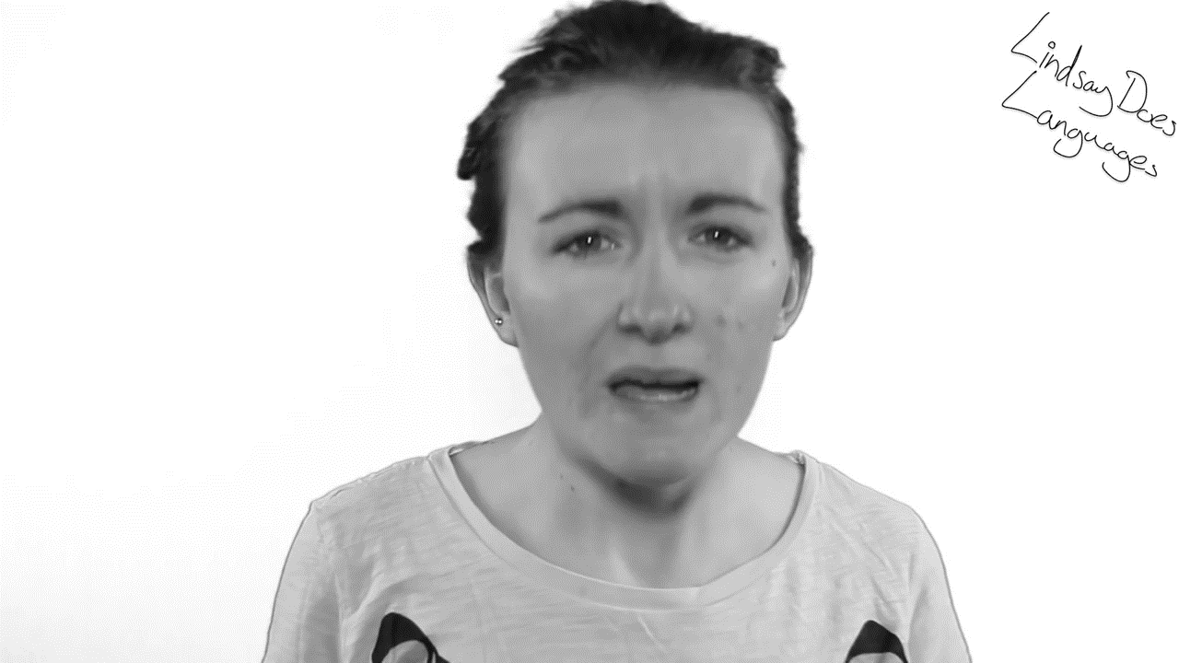
https://www.youtube.com/watch?v=HpTfl_GqPUs

Slide 3


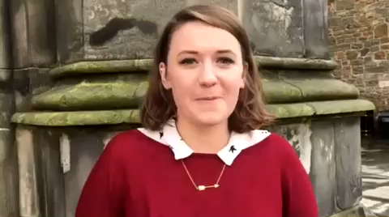

Zoë Ketley
2005 - 2012
Can speak…
A-Level Languages:
French & Spanish
Has graduated with a degree in
French, Spanish & Italian
Recommends learning languages as it will give you lots of new opportunities & experiences and it will open doors!

Slide 4
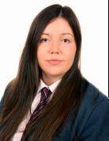

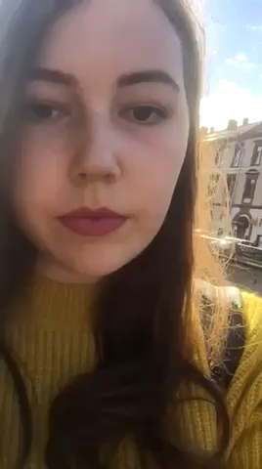

Sophie Martin
2009 - 2016
Can speak…
A-Level Languages:
French & German
Currently studying French & Russian
Loves using her languages to explore new cultures, get to know new people and broaden her horizons

Slide 5
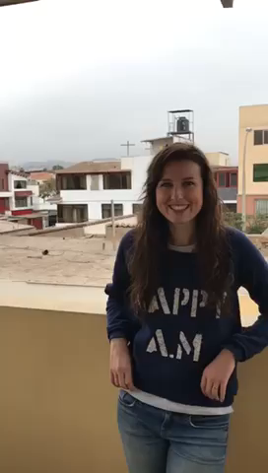



Mrs. Agnew Peru 2017
Mrs. Agnew has taken a career break from Strathearn to do voluntary work in Peru. Her Spanish will be phenomenal when she returns in September.

Slide 6
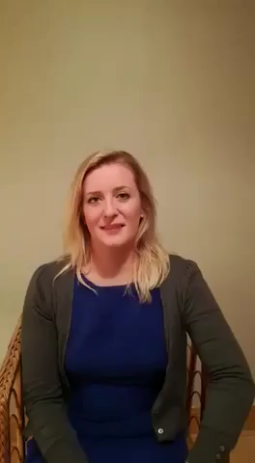

Katie Scott
2000 - 2007
Can speak…
A-Level Languages:
French & Spanish
Graduated with a degree in Mandarin and Spanish with Management
Works a as a management consultant for Price Waterhouse Coopers.
Languages gave her lots of opportunities and friendships from across the world

Slide 7
What languages will you speak?

